Slide 1
Data Mining
Practical Machine Learning Tools and Techniques
Slides for Chapter 4 of Data Mining by I. H. Witten, E. Frank and
M. A. Hall

Slide 2
Algorithms: The basic methods
Inferring rudimentary rules
Statistical modeling
Constructing decision trees
Constructing rules
Association rule learning
Linear models
Instance-based learning
Clustering

Slide 3
Simplicity first
Simple algorithms often work very well!
There are many kinds of simple structure, eg:
  One attribute does all the work
  All attributes contribute equally & independently
  A weighted linear combination might do
  Instance-based: use a few prototypes
  Use simple logical rules
Success of method depends on the domain

Slide 4
Inferring rudimentary rules
1R: learns a 1-level decision tree
  I.e., rules that all test one particular attribute
Basic version
  One branch for each value
  Each branch assigns most frequent class
  Error rate: proportion of instances that don’t belong to the majority class of their corresponding branch
  Choose attribute with lowest error rate
(assumes nominal attributes)

Slide 5
Pseudo-code for 1R
For each attribute,
For each value of the attribute, make a rule as follows:
count how often each class appears
find the most frequent class
make the rule assign that class to this attribute-value
Calculate the error rate of the rules
Choose the rules with the smallest error rate
Note: “missing” is treated as a separate attribute value

Slide 6
Evaluating the weather attributes
Outlook
Temp
Humidity
Windy
Play
Sunny
Hot
High
False
No
Attribute
Rules
Errors
Total errors
Sunny
Hot
High
True
No
Outlook
Sunny → No
2/5
4/14
Overcast
Hot
High
False
Yes
Overcast → Yes
0/4
Rainy
Mild
High
False
Yes
Rainy → Yes
2/5
Rainy
Cool
Normal
False
Yes
Temp
Hot → No*
2/4
5/14
Rainy
Cool
Normal
True
No
Mild → Yes
2/6
Overcast
Cool
Normal
True
Yes
Cool → Yes
1/4
Sunny
Mild
High
False
No
Humidity
High → No
3/7
4/14
Sunny
Cool
Normal
False
Yes
Normal → Yes
1/7
Rainy
Mild
Normal
False
Yes
Windy
False → Yes
2/8
5/14
Sunny
Mild
Normal
True
Yes
True → No*
3/6
Overcast
Mild
High
True
Yes
Overcast
Hot
Normal
False
Yes
Rainy
Mild
High
True
No
* indicates a tie

Slide 7
Dealing with numeric attributes
Discretize numeric attributes
Divide each attribute’s range into intervals
  Sort instances according to attribute’s values
  Place breakpoints where class changes (majority class)
  This minimizes the total error
Example: temperature from weather data
64 65 68 69 70 71 72 72 75 75 80 81 83 85
Yes | No | Yes Yes Yes | No No Yes | Yes Yes | No | Yes Yes | No
Outlook
Temperature
Humidity
Windy
Play
Sunny
85
85
False
No
Sunny
80
90
True
No
Overcast
83
86
False
Yes
Rainy
75
80
False
Yes
…
…
…
…
…

Slide 8
The problem of overfitting
This procedure is very sensitive to noise
  One instance with an incorrect class label will probably produce a separate interval
Also: time stamp attribute will have zero errors
Simple solution:
enforce minimum number of instances in majority class per interval
Example (with min = 3):
64 65 68 69 70 71 72 72 75 75 80 81 83 85
Yes | No | Yes Yes Yes | No No Yes | Yes Yes | No | Yes Yes | No
64 65 68 69 70 71 72 72 75 75 80 81 83 85
Yes No Yes Yes Yes | No No Yes Yes Yes | No Yes Yes No

Slide 9
With overfitting avoidance
Resulting rule set:
Attribute
Rules
Errors
Total errors
Outlook
Sunny → No
2/5
4/14
Overcast → Yes
0/4
Rainy → Yes
2/5
Temperature
≤ 77.5 → Yes
3/10
5/14
> 77.5 → No*
2/4
Humidity
≤ 82.5 → Yes
1/7
3/14
> 82.5 and ≤ 95.5 → No
2/6
> 95.5 → Yes
0/1
Windy
False → Yes
2/8
5/14
True → No*
3/6

Slide 10

Discussion of 1R
1R was described in a paper by Holte (1993)
  Contains an experimental evaluation on 16 datasets (using cross-validation so that results were representative of performance on future data)
  Minimum number of instances was set to 6 after some experimentation
  1R’s simple rules performed not much worse than much more complex decision trees
Simplicity first pays off!
Very Simple Classification Rules Perform Well on Most Commonly Used Datasets
Robert C. Holte, Computer Science Department, University of Ottawa

Slide 11
Discussion of 1R: Hyperpipes
Another simple technique: build one rule for each class
  Each rule is a conjunction of tests, one for each attribute
  For numeric attributes: test checks whether instance's value is inside an interval
    Interval given by minimum and maximum observed in training data
  For nominal attributes: test checks whether value is one of a subset of attribute values
    Subset given by all possible values observed in training data
  Class with most matching tests is predicted

Slide 12
Statistical modeling
“Opposite” of 1R: use all the attributes
Two assumptions: Attributes are
  equally important
  statistically independent (given the class value)
    I.e., knowing the value of one attribute says nothing about the value of another (if the class is known)
Independence assumption is never correct!
But … this scheme works well in practice

Slide 13
Probabilities for weather data
Outlook
Temperature
Humidity
Windy
Play
Yes
No
Yes
No
Yes
No
Yes
No
Yes
No
Sunny
2
3
Hot
2
2
High
3
4
False
6
2
9
5
Overcast
4
0
Mild
4
2
Normal
6
1
True
3
3
Rainy
3
2
Cool
3
1
Sunny
2/9
3/5
Hot
2/9
2/5
High
3/9
4/5
False
6/9
2/5
9/
14
5/
14
Overcast
4/9
0/5
Mild
4/9
2/5
Normal
6/9
1/5
True
3/9
3/5
Rainy
3/9
2/5
Cool
3/9
1/5
Outlook
Temp
Humidity
Windy
Play
Sunny
Hot
High
False
No
Sunny
Hot
High
True
No
Overcast
Hot
High
False
Yes
Rainy
Mild
High
False
Yes
Rainy
Cool
Normal
False
Yes
Rainy
Cool
Normal
True
No
Overcast
Cool
Normal
True
Yes
Sunny
Mild
High
False
No
Sunny
Cool
Normal
False
Yes
Rainy
Mild
Normal
False
Yes
Sunny
Mild
Normal
True
Yes
Overcast
Mild
High
True
Yes
Overcast
Hot
Normal
False
Yes
Rainy
Mild
High
True
No

Slide 14
Probabilities for weather data
Outlook
Temperature
Humidity
Windy
Play
Yes
No
Yes
No
Yes
No
Yes
No
Yes
No
Sunny
2
3
Hot
2
2
High
3
4
False
6
2
9
5
Overcast
4
0
Mild
4
2
Normal
6
1
True
3
3
Rainy
3
2
Cool
3
1
Sunny
2/9
3/5
Hot
2/9
2/5
High
3/9
4/5
False
6/9
2/5
9/
14
5/
14
Overcast
4/9
0/5
Mild
4/9
2/5
Normal
6/9
1/5
True
3/9
3/5
Rainy
3/9
2/5
Cool
3/9
1/5
A new day:
Outlook
Temp.
Humidity
Windy
Play
Sunny
Cool
High
True
?
Likelihood of the two classes
For “yes” = 2/9 × 3/9 × 3/9 × 3/9 × 9/14 = 0.0053
For “no” = 3/5 × 1/5 × 4/5 × 3/5 × 5/14 = 0.0206
Conversion into a probability by normalization:
P(“yes”) = 0.0053 / (0.0053 + 0.0206) = 0.205
P(“no”) = 0.0206 / (0.0053 + 0.0206) = 0.795

Slide 15
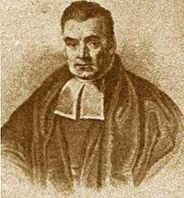
Bayes’s rule
Probability of event H given evidence E:
A priori probability of H :
  Probability of event before evidence is seen
A posteriori probability of H :
  Probability of event after evidence is seen
Thomas Bayes
Born: 1702 in London, England
Died: 1761 in Tunbridge Wells, Kent, England

Slide 16
Naïve Bayes for classification
Classification learning: what’s the probability of the class given an instance?
  Evidence E = instance
  Event H = class value for instance
Naïve assumption: evidence splits into parts (i.e. attributes) that are independent

Slide 17
Weather data example
Outlook
Temp.
Humidity
Windy
Play
Evidence E
Sunny
Cool
High
True
?
Probability of
class “yes”

Slide 18
The “zero-frequency problem”
What if an attribute value doesn’t occur with every class value?
(e.g. “Humidity = high” for class “yes”)
  Probability will be zero!
  A posteriori probability will also be zero!
  (No matter how likely the other values are!)
Remedy: add 1 to the count for every attribute value-class combination (Laplace estimator)
Result: probabilities will never be zero!
(also: stabilizes probability estimates)

Slide 19
Modified probability estimates
In some cases adding a constant different from 1 might be more appropriate
Example: attribute outlook for class yes
Weights don’t need to be equal
(but they must sum to 1)
Sunny
Overcast
Rainy

Slide 20
Missing values
Training: instance is not included in frequency count for attribute value-class combination
Classification: attribute will be omitted from calculation
Example:
Outlook
Temp.
Humidity
Windy
Play
?
Cool
High
True
?
Likelihood of “yes” = 3/9 × 3/9 × 3/9 × 9/14 = 0.0238
Likelihood of “no” = 1/5 × 4/5 × 3/5 × 5/14 = 0.0343
P(“yes”) = 0.0238 / (0.0238 + 0.0343) = 41%
P(“no”) = 0.0343 / (0.0238 + 0.0343) = 59%

Slide 21
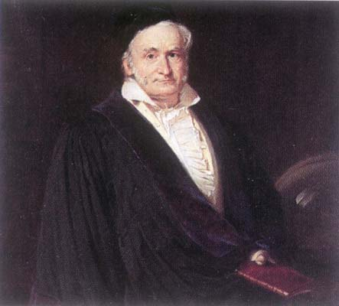
Numeric attributes
Usual assumption: attributes have a normal or Gaussian probability distribution (given the class)
The probability density function for the normal distribution is defined by two parameters:
  Sample mean μ
  Standard deviation σ
  Then the density function f(x) is

Slide 22
Statistics for weather data
Outlook
Temperature
Humidity
Windy
Play
Yes
No
Yes
No
Yes
No
Yes
No
Yes
No
Sunny
2
3
64, 68,
65,71,
65, 70,
70, 85,
False
6
2
9
5
Overcast
4
0
69, 70,
72,80,
70, 75,
90, 91,
True
3
3
Rainy
3
2
72, …
85, …
80, …
95, …
Sunny
2/9
3/5
μ =73
μ =75
μ =79
μ =86
False
6/9
2/5
9/
14
5/
14
Overcast
4/9
0/5
σ =6.2
σ =7.9
σ =10.2
σ =9.7
True
3/9
3/5
Rainy
3/9
2/5
Example density value:

Slide 23
Classifying a new day
A new day:
Missing values during training are not included in calculation of mean and standard deviation
Outlook
Temp.
Humidity
Windy
Play
Sunny
66
90
true
?
Likelihood of “yes” = 2/9 × 0.0340 × 0.0221 × 3/9 × 9/14 = 0.000036
Likelihood of “no” = 3/5 × 0.0221 × 0.0381 × 3/5 × 5/14 = 0.000108
P(“yes”) = 0.000036 / (0.000036 + 0. 000108) = 25%
P(“no”) = 0.000108 / (0.000036 + 0. 000108) = 75%

Slide 24
Probability densities
Relationship between probability and density:
But: this doesn’t change calculation of a posteriori probabilities because ε cancels out
Exact relationship:

Slide 25
Multinomial naïve Bayes I
Version of naïve Bayes used for document classification using bag of words model
n1,n2, ... , nk: number of times word i occurs in document
P1,P2, ... , Pk: probability of obtaining word i when sampling from documents in class H
Probability of observing document E given class H (based on multinomial distribution):
Ignores probability of generating a document of the right length (prob. assumed constant for each class)

Slide 26
Multinomial naïve Bayes II
Suppose dictionary has two words, yellow and blue
Suppose Pr[yellow | H] = 75% and Pr[blue | H] = 25%
Suppose E is the document “blue yellow blue”
Probability of observing document:
Suppose there is another class H' that has
Pr[yellow | H'] = 10% and Pr[yellow | H'] = 90%:
Need to take prior probability of class into account to make final classification
Factorials don't actually need to be computed
Underflows can be prevented by using logarithms

Slide 27
Naïve Bayes: discussion
Naïve Bayes works surprisingly well (even if independence assumption is clearly violated)
Why? Because classification doesn’t require accurate probability estimates as long as maximum probability is assigned to correct class
However: adding too many redundant attributes will cause problems (e.g. identical attributes)
Note also: many numeric attributes are not normally distributed (→ kernel density estimators)

Slide 28
Constructing decision trees
Strategy: top down
Recursive divide-and-conquer fashion
  First: select attribute for root node
  Create branch for each possible attribute value
  Then: split instances into subsets
  One for each branch extending from the node
  Finally: repeat recursively for each branch, using only instances that reach the branch
Stop if all instances have the same class

Slide 29
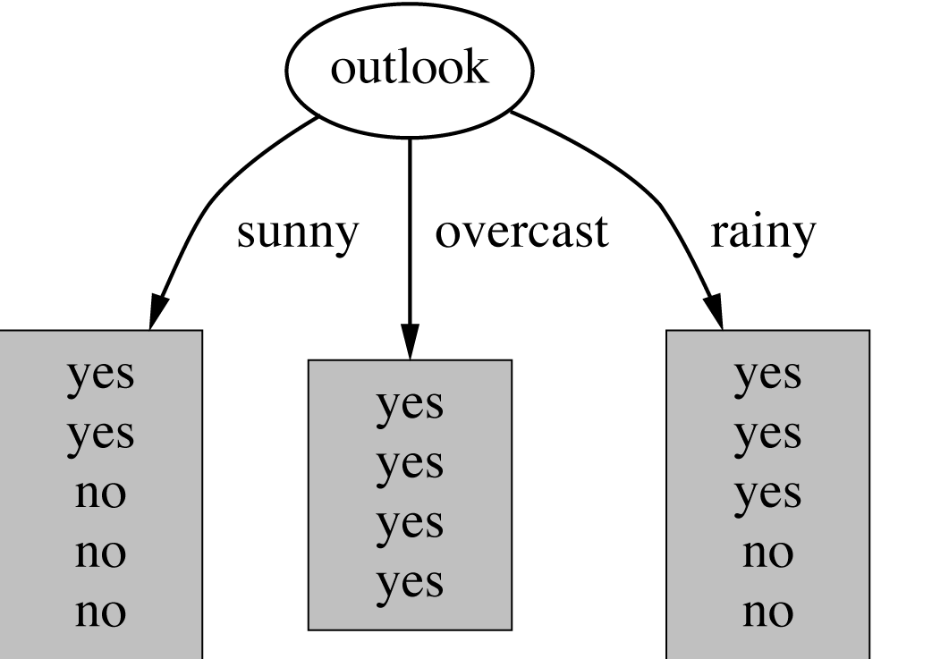
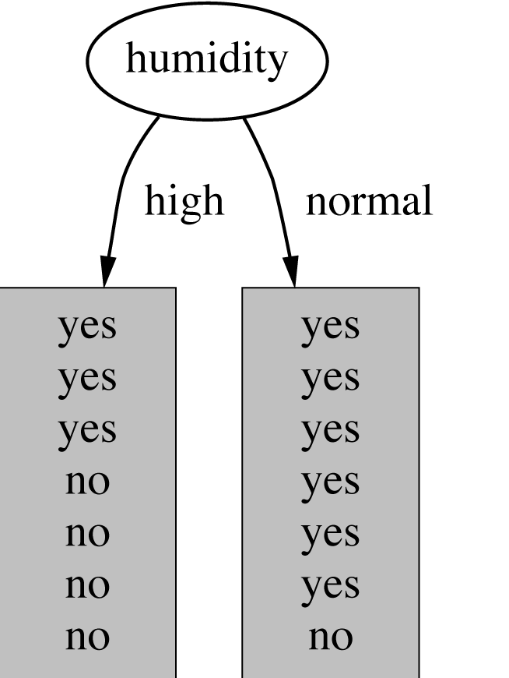
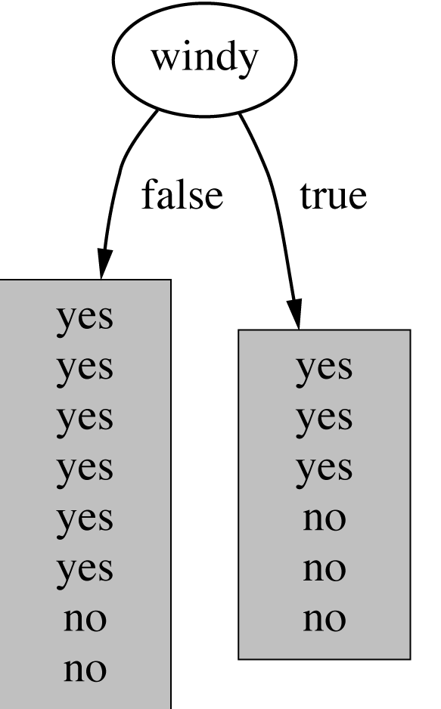
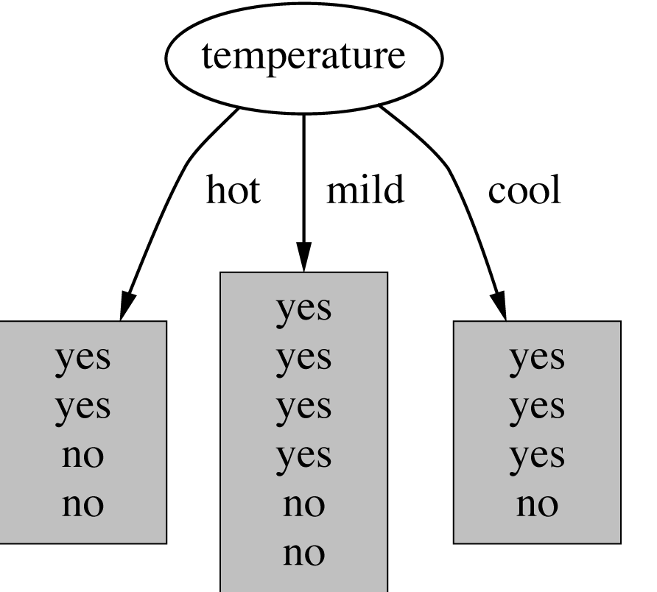
Which attribute to select?

Slide 30
Which attribute to select?

Slide 31
Criterion for attribute selection
Which is the best attribute?
  Want to get the smallest tree
  Heuristic: choose the attribute that produces the “purest” nodes
Popular impurity criterion: information gain
  Information gain increases with the average purity of the subsets
Strategy: choose attribute that gives greatest information gain

Slide 32
Computing information
Measure information in bits
  Given a probability distribution, the info required to predict an event is the distribution’s entropy
  Entropy gives the information required in bits
  (can involve fractions of bits!)
Formula for computing the entropy:

Slide 33
Example: attribute Outlook
Outlook = Sunny :
Outlook = Overcast :
Outlook = Rainy :
Expected information for attribute:
Note: this
is normally
undefined.

Slide 34
Computing information gain
Information gain: information before splitting – information after splitting
Information gain for attributes from weather data:
gain(Outlook ) = info([9,5]) – info([2,3],[4,0],[3,2])
= 0.940 – 0.693
= 0.247 bits
gain(Outlook ) = 0.247 bits
gain(Temperature ) = 0.029 bits
gain(Humidity ) = 0.152 bits
gain(Windy ) = 0.048 bits

Slide 35
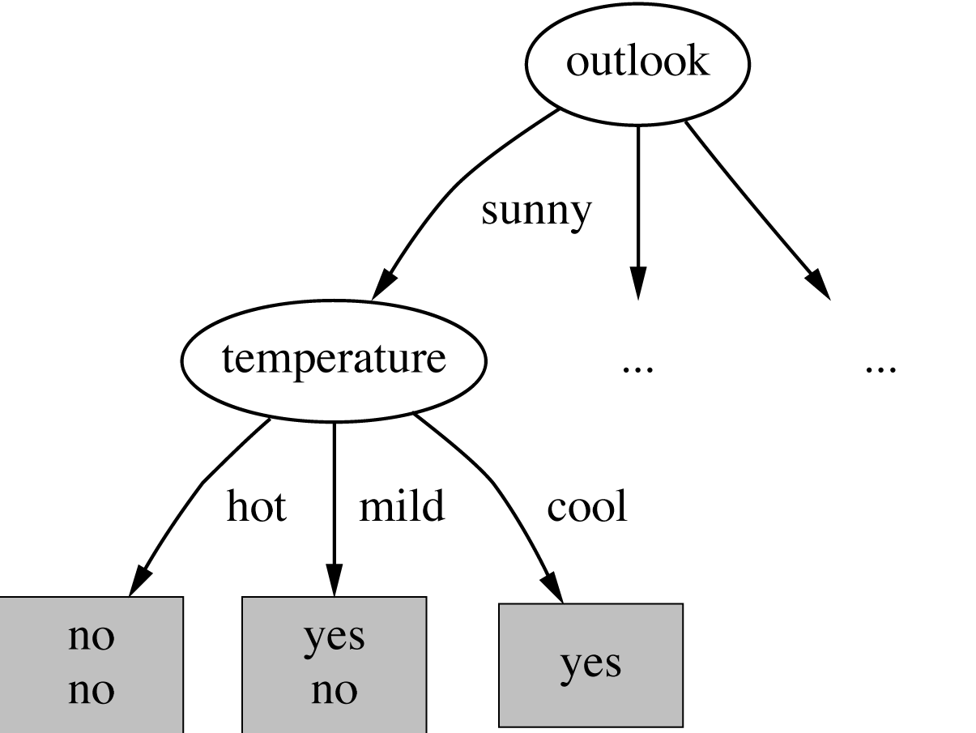
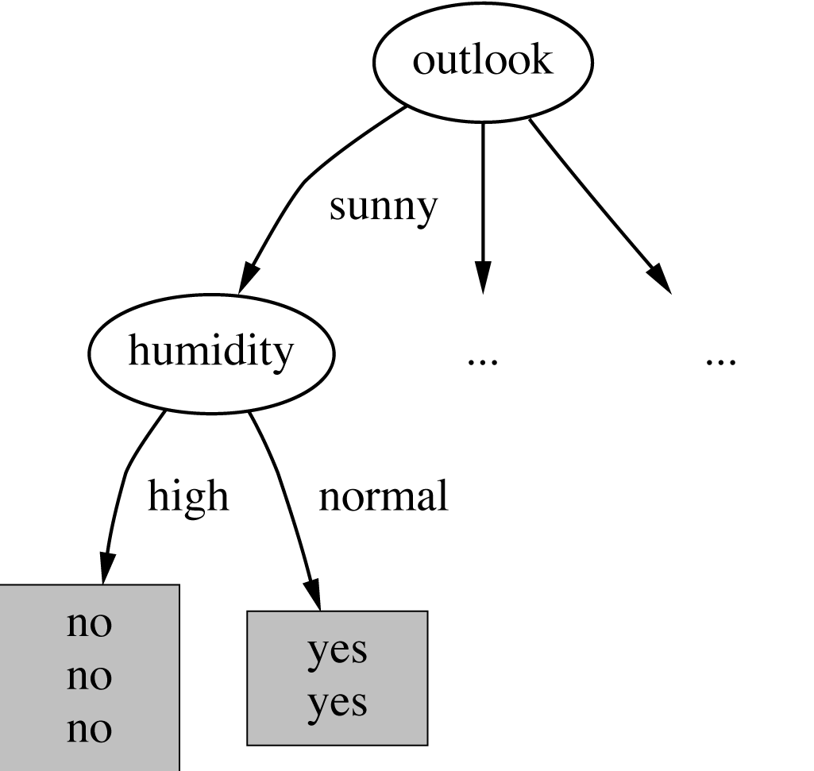
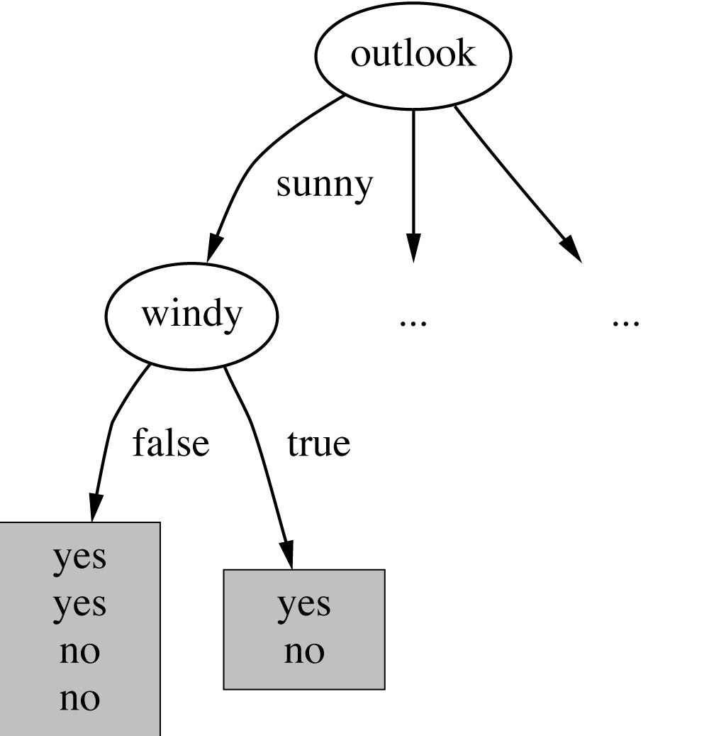
Continuing to split
gain(Temperature ) = 0.571 bits
gain(Humidity ) = 0.971 bits
gain(Windy ) = 0.020 bits

Slide 36
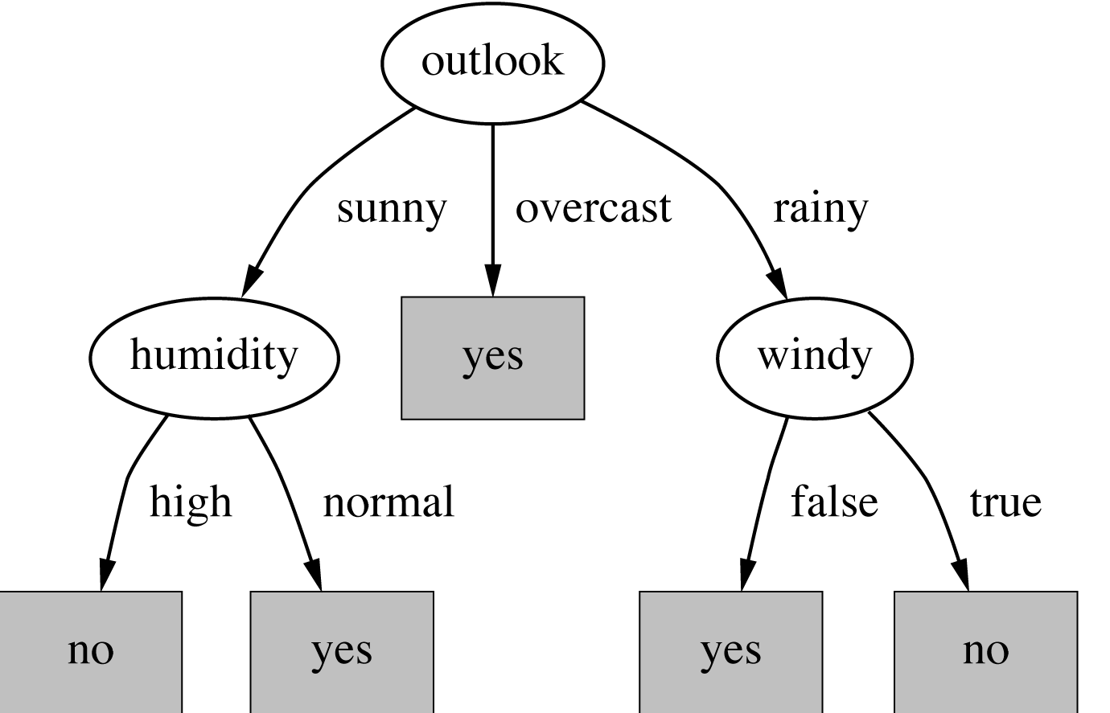
Final decision tree
Note: not all leaves need to be pure; sometimes identical instances have different classes
⇒ Splitting stops when data can’t be split any further

Slide 37
Wishlist for a purity measure
Properties we require from a purity measure:
  When node is pure, measure should be zero
  When impurity is maximal (i.e. all classes equally likely), measure should be maximal
  Measure should obey multistage property (i.e. decisions can be made in several stages):
Entropy is the only function that satisfies all three properties!

Slide 38
Properties of the entropy
The multistage property:
Simplification of computation:
Note: instead of maximizing info gain we could just minimize information

Slide 39
Highly-branching attributes
Problematic: attributes with a large number of values (extreme case: ID code)
Subsets are more likely to be pure if there is a large number of values
  Information gain is biased towards choosing attributes with a large number of values
  This may result in overfitting (selection of an attribute that is non-optimal for prediction)
Another problem: fragmentation

Slide 40
Weather data with ID code
ID code
Outlook
Temp.
Humidity
Windy
Play
A
Sunny
Hot
High
False
No
B
Sunny
Hot
High
True
No
C
Overcast
Hot
High
False
Yes
D
Rainy
Mild
High
False
Yes
E
Rainy
Cool
Normal
False
Yes
F
Rainy
Cool
Normal
True
No
G
Overcast
Cool
Normal
True
Yes
H
Sunny
Mild
High
False
No
I
Sunny
Cool
Normal
False
Yes
J
Rainy
Mild
Normal
False
Yes
K
Sunny
Mild
Normal
True
Yes
L
Overcast
Mild
High
True
Yes
M
Overcast
Hot
Normal
False
Yes
N
Rainy
Mild
High
True
No

Slide 41
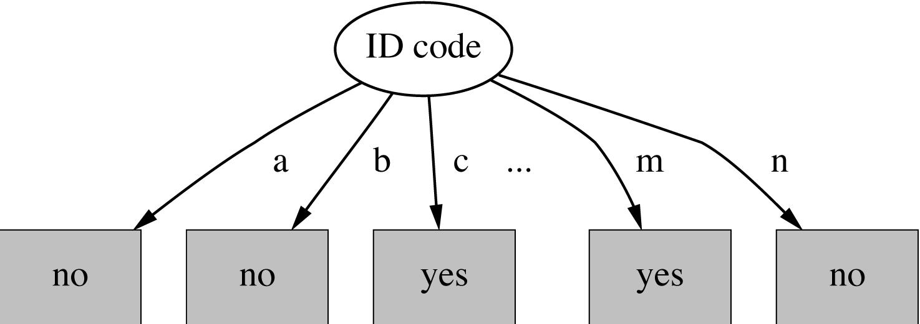
Tree stump for ID code attribute
Entropy of split:
  Information gain is maximal for ID code (namely 0.940 bits)

Slide 42
Gain ratio
Gain ratio: a modification of the information gain that reduces its bias
Gain ratio takes number and size of branches into account when choosing an attribute
  It corrects the information gain by taking the intrinsic information of a split into account
Intrinsic information: entropy of distribution of instances into branches (i.e. how much info do we need to tell which branch an instance belongs to)

Slide 43
Computing the gain ratio
Example: intrinsic information for ID code
Value of attribute decreases as intrinsic information gets larger
Definition of gain ratio:
Example:

Slide 44
Gain ratios for weather data
Outlook
Temperature
Info:
0.693
Info:
0.911
Gain: 0.940-0.693
0.247
Gain: 0.940-0.911
0.029
Split info: info([5,4,5])
1.577
Split info: info([4,6,4])
1.557
Gain ratio: 0.247/1.577
0.157
Gain ratio: 0.029/1.557
0.019
Humidity
Windy
Info:
0.788
Info:
0.892
Gain: 0.940-0.788
0.152
Gain: 0.940-0.892
0.048
Split info: info([7,7])
1.000
Split info: info([8,6])
0.985
Gain ratio: 0.152/1
0.152
Gain ratio: 0.048/0.985
0.049

Slide 45
More on the gain ratio
“Outlook” still comes out top
However: “ID code” has greater gain ratio
  Standard fix: ad hoc test to prevent splitting on that type of attribute
Problem with gain ratio: it may overcompensate
  May choose an attribute just because its intrinsic information is very low
  Standard fix: only consider attributes with greater than average information gain

Slide 46
Discussion
Top-down induction of decision trees: ID3, algorithm developed by Ross Quinlan
  Gain ratio just one modification of this basic algorithm
  ⇒ C4.5: deals with numeric attributes, missing values, noisy data
Similar approach: CART
There are many other attribute selection criteria!
(But little difference in accuracy of result)

Slide 47
Covering algorithms
Convert decision tree into a rule set
  Straightforward, but rule set overly complex
  More effective conversions are not trivial
Instead, can generate rule set directly
  for each class in turn find rule set that covers all instances in it
  (excluding instances not in the class)
Called a covering approach:
  at each stage a rule is identified that “covers” some of the instances

Slide 48
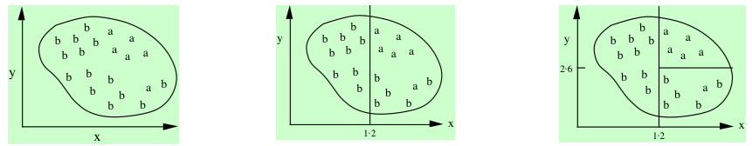
Example: generating a rule
If true
then class = a
If x > 1.2 and y > 2.6
then class = a
If x > 1.2
then class = a
Possible rule set for class “b”:
Could add more rules, get “perfect” rule set
If x ≤ 1.2 then class = b
If x > 1.2 and y ≤ 2.6 then class = b

Slide 49
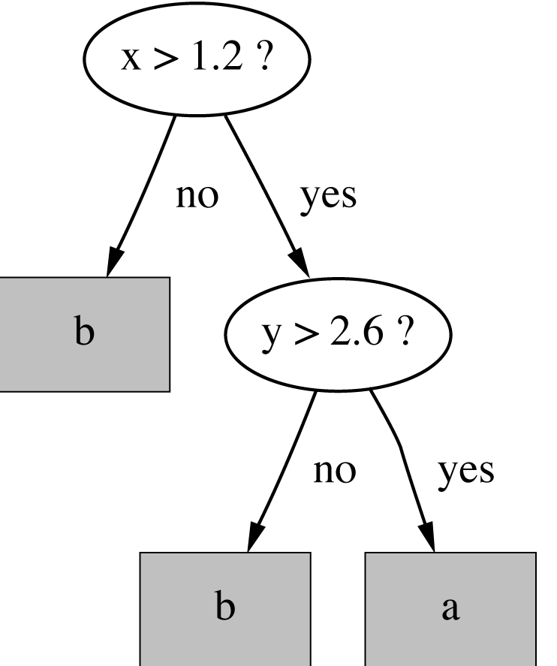
Rules vs. trees
Corresponding decision tree:
(produces exactly the same
predictions)
But: rule sets can be more perspicuous when decision trees suffer from replicated subtrees
Also: in multiclass situations, covering algorithm concentrates on one class at a time whereas decision tree learner takes all classes into account

Slide 50
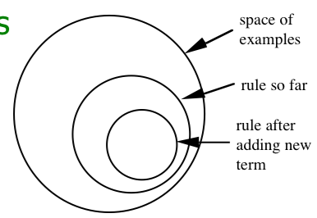
Simple covering algorithm
Generates a rule by adding tests that maximize rule’s accuracy
Similar to situation in decision trees: problem of selecting an attribute to split on
  But: decision tree inducer maximizes overall purity
Each new test reduces
rule’s coverage:

Slide 51
Selecting a test
Goal: maximize accuracy
  t total number of instances covered by rule
  p positive examples of the class covered by rule
  t – p number of errors made by rule
  Select test that maximizes the ratio p/t
We are finished when p/t = 1 or the set of instances can’t be split any further

Slide 52
Example: contact lens data
If ?
then recommendation = hard
Rule we seek:
Possible tests:
Age = Young
2/8
Age = Pre-presbyopic
1/8
Age = Presbyopic
1/8
Spectacle prescription = Myope
3/12
Spectacle prescription = Hypermetrope
1/12
Astigmatism = no
0/12
Astigmatism = yes
4/12
Tear production rate = Reduced
0/12
Tear production rate = Normal
4/12

Slide 53
Modified rule and resulting data
Rule with best test added:
Instances covered by modified rule:
If astigmatism = yes
then recommendation = hard
Age
Spectacle prescription
Astigmatism
Tear production rate
Recommended lenses
Young
Myope
Yes
Reduced
None
Young
Myope
Yes
Normal
Hard
Young
Hypermetrope
Yes
Reduced
None
Young
Hypermetrope
Yes
Normal
hard
Pre-presbyopic
Myope
Yes
Reduced
None
Pre-presbyopic
Myope
Yes
Normal
Hard
Pre-presbyopic
Hypermetrope
Yes
Reduced
None
Pre-presbyopic
Hypermetrope
Yes
Normal
None
Presbyopic
Myope
Yes
Reduced
None
Presbyopic
Myope
Yes
Normal
Hard
Presbyopic
Hypermetrope
Yes
Reduced
None
Presbyopic
Hypermetrope
Yes
Normal
None

Slide 54
Further refinement
If astigmatism = yes
and ?
then recommendation = hard
Current state:
Possible tests:
Age = Young
2/4
Age = Pre-presbyopic
1/4
Age = Presbyopic
1/4
Spectacle prescription = Myope
3/6
Spectacle prescription = Hypermetrope
1/6
Tear production rate = Reduced
0/6
Tear production rate = Normal
4/6

Slide 55
Modified rule and resulting data
Rule with best test added:
Instances covered by modified rule:
If astigmatism = yes
and tear production rate = normal then recommendation = hard
Age
Spectacle prescription
Astigmatism
Tear production rate
Recommended lenses
Young
Myope
Yes
Normal
Hard
Young
Hypermetrope
Yes
Normal
hard
Pre-presbyopic
Myope
Yes
Normal
Hard
Pre-presbyopic
Hypermetrope
Yes
Normal
None
Presbyopic
Myope
Yes
Normal
Hard
Presbyopic
Hypermetrope
Yes
Normal
None

Slide 56
Further refinement
Current state:
Possible tests:
Tie between the first and the fourth test
  We choose the one with greater coverage
If astigmatism = yes
and tear production rate = normal
and ?
then recommendation = hard
Age = Young
2/2
Age = Pre-presbyopic
1/2
Age = Presbyopic
1/2
Spectacle prescription = Myope
3/3
Spectacle prescription = Hypermetrope
1/3

Slide 57
The result
Final rule:
Second rule for recommending “hard lenses”:
(built from instances not covered by first rule)
These two rules cover all “hard lenses”:
  Process is repeated with other two classes
If astigmatism = yes
and tear production rate = normal
and spectacle prescription = myope
then recommendation = hard
If age = young and astigmatism = yes
and tear production rate = normal
then recommendation = hard

Slide 58
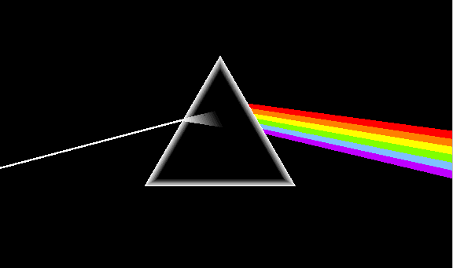
Pseudo-code for PRISM
For each class C
Initialize E to the instance set
While E contains instances in class C
Create a rule R with an empty left-hand side that predicts class C
Until R is perfect (or there are no more attributes to use) do
For each attribute A not mentioned in R, and each value v,
Consider adding the condition A = v to the left-hand side of R
Select A and v to maximize the accuracy p/t
(break ties by choosing the condition with the largest p)
Add A = v to R
Remove the instances covered by R from E

Slide 59
Rules vs. decision lists
PRISM with outer loop removed generates a decision list for one class
  Subsequent rules are designed for rules that are not covered by previous rules
  But: order doesn’t matter because all rules predict the same class
Outer loop considers all classes separately
  No order dependence implied
Problems: overlapping rules, default rule required

Slide 60
Separate and conquer
Methods like PRISM (for dealing with one class) are separate-and-conquer algorithms:
  First, identify a useful rule
  Then, separate out all the instances it covers
  Finally, “conquer” the remaining instances
Difference to divide-and-conquer methods:
  Subset covered by rule doesn’t need to be explored any further

Slide 61
Mining association rules
Naïve method for finding association rules:
  Use separate-and-conquer method
  Treat every possible combination of attribute values as a separate class
Two problems:
  Computational complexity
  Resulting number of rules (which would have to be pruned on the basis of support and confidence)
But: we can look for high support rules directly!

Slide 62
Item sets
Support: number of instances correctly covered by association rule
  The same as the number of instances covered by all tests in the rule (LHS and RHS!)
Item: one test/attribute-value pair
Item set : all items occurring in a rule
Goal: only rules that exceed pre-defined support
⇒ Do it by finding all item sets with the given minimum support and generating rules from them!

Slide 63
Weather data
Outlook
Temp
Humidity
Windy
Play
Sunny
Hot
High
False
No
Sunny
Hot
High
True
No
Overcast
Hot
High
False
Yes
Rainy
Mild
High
False
Yes
Rainy
Cool
Normal
False
Yes
Rainy
Cool
Normal
True
No
Overcast
Cool
Normal
True
Yes
Sunny
Mild
High
False
No
Sunny
Cool
Normal
False
Yes
Rainy
Mild
Normal
False
Yes
Sunny
Mild
Normal
True
Yes
Overcast
Mild
High
True
Yes
Overcast
Hot
Normal
False
Yes
Rainy
Mild
High
True
No

Slide 64
Item sets for weather data
One-item sets
Two-item sets
Three-item sets
Four-item sets
Outlook = Sunny (5)
Outlook = Sunny
Temperature = Hot (2)
Outlook = Sunny
Temperature = Hot
Humidity = High (2)
Outlook = Sunny
Temperature = Hot
Humidity = High
Play = No (2)
Temperature = Cool (4)
Outlook = Sunny
Humidity = High (3)
Outlook = Sunny
Humidity = High
Windy = False (2)
Outlook = Rainy
Temperature = Mild
Windy = False
Play = Yes (2)
…
…
…
…
In total: 12 one-item sets, 47 two-item sets, 39 three-item sets, 6 four-item sets and 0 five-item sets (with minimum support of two)

Slide 65
Generating rules from an item set
Once all item sets with minimum support have been generated, we can turn them into rules
Example:
Seven (2^{N}-1) potential rules:
Humidity = Normal, Windy = False, Play = Yes (4)
If Humidity = Normal and Windy = False then Play = Yes
If Humidity = Normal and Play = Yes then Windy = False
If Windy = False and Play = Yes then Humidity = Normal
If Humidity = Normal then Windy = False and Play = Yes
If Windy = False then Humidity = Normal and Play = Yes
If Play = Yes then Humidity = Normal and Windy = False
If True then Humidity = Normal and Windy = False
and Play = Yes
4/4
4/6
4/6
4/7
4/8
4/9
4/12

Slide 66
Rules for weather data
Rules with support > 1 and confidence = 100%:
In total:
3 rules with support four
5 with support three
50 with support two
Association rule
Sup.
Conf.
1
Humidity=Normal Windy=False
⇒ Play=Yes
4
100%
2
Temperature=Cool
⇒ Humidity=Normal
4
100%
3
Outlook=Overcast
⇒ Play=Yes
4
100%
4
Temperature=Cold Play=Yes
⇒ Humidity=Normal
3
100%
...
...
...
...
58
Outlook=Sunny Temperature=Hot
⇒ Humidity=High
2
100%

Slide 67
Example rules from the same set
Item set:
Resulting rules (all with 100% confidence):
due to the following “frequent” item sets:
Temperature = Cool, Humidity = Normal, Windy = False, Play = Yes (2)
Temperature = Cool, Windy = False ⇒ Humidity = Normal, Play = Yes
Temperature = Cool, Windy = False, Humidity = Normal ⇒ Play = Yes
Temperature = Cool, Windy = False, Play = Yes ⇒ Humidity = Normal
Temperature = Cool, Windy = False (2)
Temperature = Cool, Humidity = Normal, Windy = False (2)
Temperature = Cool, Windy = False, Play = Yes (2)

Slide 68
Generating item sets efficiently
How can we efficiently find all frequent item sets?
Finding one-item sets easy
Idea: use one-item sets to generate two-item sets, two-item sets to generate three-item sets, …
  If (A B) is frequent item set, then (A) and (B) have to be frequent item sets as well!
  In general: if X is frequent k-item set, then all (k-1)-item subsets of X are also frequent
⇒ Compute k-item set by merging (k-1)-item sets

Slide 69
Example
Given: five three-item sets
(A B C), (A B D), (A C D), (A C E), (B C D)
Lexicographically ordered!
Candidate four-item sets:
(A B C D) OK because of (A C D) (B C D)
(A C D E) Not OK because of (C D E)
Final check by counting instances in dataset!
(k –1)-item sets are stored in hash table

Slide 70
Generating rules efficiently
We are looking for all high-confidence rules
  Support of antecedent obtained from hash table
  But: brute-force method is (2^{N}-1)
Better way: building (c + 1)-consequent rules from c-consequent ones
  Observation: (c + 1)-consequent rule can only hold if all corresponding c-consequent rules also hold
Resulting algorithm similar to procedure for large item sets

Slide 71
Example
1-consequent rules:
Corresponding 2-consequent rule:
Final check of antecedent against hash table!
If Outlook = Sunny and Windy = False and Play = No
then Humidity = High (2/2)
If Humidity = High and Windy = False and Play = No
then Outlook = Sunny (2/2)
If Windy = False and Play = No
then Outlook = Sunny and Humidity = High (2/2)

Slide 72
Association rules: discussion
Above method makes one pass through the data for each different size item set
  Other possibility: generate (k+2)-item sets just after (k+1)-item sets have been generated
  Result: more (k+2)-item sets than necessary will be considered but less passes through the data
  Makes sense if data too large for main memory
Practical issue: generating a certain number of rules (e.g. by incrementally reducing min. support)

Slide 73
Other issues
Standard ARFF format very inefficient for typical market basket data
  Attributes represent items in a basket and most items are usually missing
  Data should be represented in sparse format
Instances are also called transactions
Confidence is not necessarily the best measure
  Example: milk occurs in almost every supermarket transaction
  Other measures have been devised (e.g. lift)

Slide 74
Linear models: linear regression
Work most naturally with numeric attributes
Standard technique for numeric prediction
  Outcome is linear combination of attributes
Weights are calculated from the training data
Predicted value for first training instance a⁽¹⁾
(assuming each instance is extended with a constant attribute with value 1)

Slide 75
Minimizing the squared error
Choose k +1 coefficients to minimize the squared error on the training data
Squared error:
Derive coefficients using standard matrix operations
Can be done if there are more instances than attributes (roughly speaking)
Minimizing the absolute error is more difficult

Slide 76
Classification
Any regression technique can be used for classification
  Training: perform a regression for each class, setting the output to 1 for training instances that belong to class, and 0 for those that don’t
  Prediction: predict class corresponding to model with largest output value (membership value)
For linear regression this is known as multi-response linear regression
Problem: membership values are not in [0,1] range, so aren't proper probability estimates

Slide 77
Linear models: logistic regression
Builds a linear model for a transformed target variable
Assume we have two classes
Logistic regression replaces the target
by this target
Logit transformation maps [0,1] to (-∞ , +∞ )

Slide 78
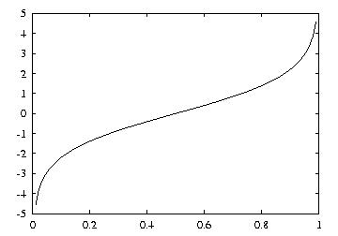
Logit transformation
Resulting model:

Slide 79
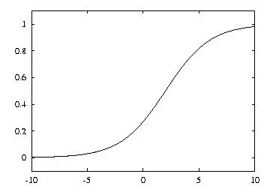
Example logistic regression model
Model with w0 = 0.5 and w1 = 1:
Parameters are found from training data using maximum likelihood

Slide 80
Maximum likelihood
Aim: maximize probability of training data wrt parameters
Can use logarithms of probabilities and maximize log-likelihood of model:
where the x^{(i)} are either 0 or 1
Weights wi need to be chosen to maximize log-likelihood (relatively simple method: iteratively re-weighted least squares)

Slide 81
Multiple classes
Can perform logistic regression independently for each class
(like multi-response linear regression)
Problem: probability estimates for different classes won't sum to one
Better: train coupled models by maximizing likelihood over all classes
Alternative that often works well in practice: pairwise classification

Slide 82
Pairwise classification
Idea: build model for each pair of classes, using only training data from those classes
Problem? Have to solve k(k-1)/2 classification problems for k-class problem
Turns out not to be a problem in many cases because training sets become small:
  Assume data evenly distributed, i.e. 2n/k per learning problem for n instances in total
  Suppose learning algorithm is linear in n
  Then runtime of pairwise classification is proportional to (k(k-1)/2)×(2n/k) = (k-1)n

Slide 83
Linear models are hyperplanes
Decision boundary for two-class logistic regression is where probability equals 0.5:
which occurs when
Thus logistic regression can only separate data that can be separated by a hyperplane
Multi-response linear regression has the same problem. Class 1 is assigned if:

Slide 84
Linear models: the perceptron
Don't actually need probability estimates if all we want to do is classification
Different approach: learn separating hyperplane
Assumption: data is linearly separable
Algorithm for learning separating hyperplane: perceptron learning rule
Hyperplane:
where we again assume that there is a constant attribute with value 1 (bias)
If sum is greater than zero we predict the first class, otherwise the second class

Slide 85
The algorithm
Set all weights to zero
Until all instances in the training data are classified correctly
For each instance I in the training data
If I is classified incorrectly by the perceptron
If I belongs to the first class add it to the weight vector
else subtract it from the weight vector
Why does this work?
Consider situation where instance a pertaining to the first class has been added:
This means output for a has increased by:
This number is always positive, thus the hyperplane has moved into the correct direction (and we can show output decreases for instances of other class)

Slide 86
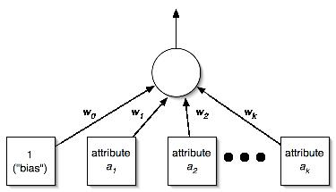
Perceptron as a neural network
Output
layer
Input
layer

Slide 87
Linear models: Winnow
Another mistake-driven algorithm for finding a separating hyperplane
  Assumes binary data (i.e. attribute values are either zero or one)
Difference: multiplicative updates instead of additive updates
  Weights are multiplied by a user-specified parameter α > 1(or its inverse)
Another difference: user-specified threshold parameter θ
  Predict first class if

Slide 88
The algorithm
while some instances are misclassified
for each instance a in the training data
classify a using the current weights
if the predicted class is incorrect
if a belongs to the first class
for each ai that is 1, multiply wi by alpha
(if ai is 0, leave wi unchanged)
otherwise
for each ai that is 1, divide wi by alpha
(if ai is 0, leave wi unchanged)
Winnow is very effective in homing in on relevant features (it is attribute efficient)
Can also be used in an on-line setting in which new instances arrive continuously
(like the perceptron algorithm)

Slide 89
Balanced Winnow
Winnow doesn't allow negative weights and this can be a drawback in some applications
Balanced Winnow maintains two weight vectors, one for each class:
Instance is classified as belonging to the first class (of two classes) if:
while some instances are misclassified
for each instance a in the training data
classify a using the current weights
if the predicted class is incorrect
if a belongs to the first class
for each ai that is 1, multiply wi⁺ by alpha and divide wi⁻ by alpha
(if ai is 0, leave wi⁺ and wi⁻ unchanged)
otherwise
for each ai that is 1, multiply wi⁻ by alpha and divide wi⁺ by alpha
(if ai is 0, leave wi⁺ and wi⁻ unchanged)

Slide 90
Instance-based learning
Distance function defines what’s learned
Most instance-based schemes use Euclidean distance:
a⁽¹⁾ and a⁽²⁾: two instances with k attributes
Taking the square root is not required when comparing distances
Other popular metric: city-block metric
  Adds differences without squaring them

Slide 91
Normalization and other issues
Different attributes are measured on different scales ⇒ need to be normalized:
v_{i} : the actual value of attribute i
Nominal attributes: distance either 0 or 1
Common policy for missing values: assumed to be maximally distant (given normalized attributes)

Slide 92
Finding nearest neighbors efficiently
Simplest way of finding nearest neighbour: linear scan of the data
  Classification takes time proportional to the product of the number of instances in training and test sets
Nearest-neighbor search can be done more efficiently using appropriate data structures
We will discuss two methods that represent training data in a tree structure:
kD-trees and ball trees

Slide 93
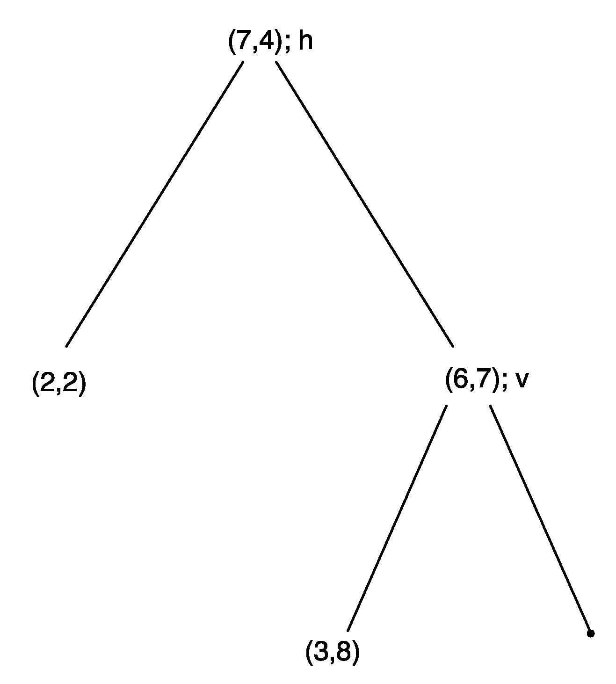
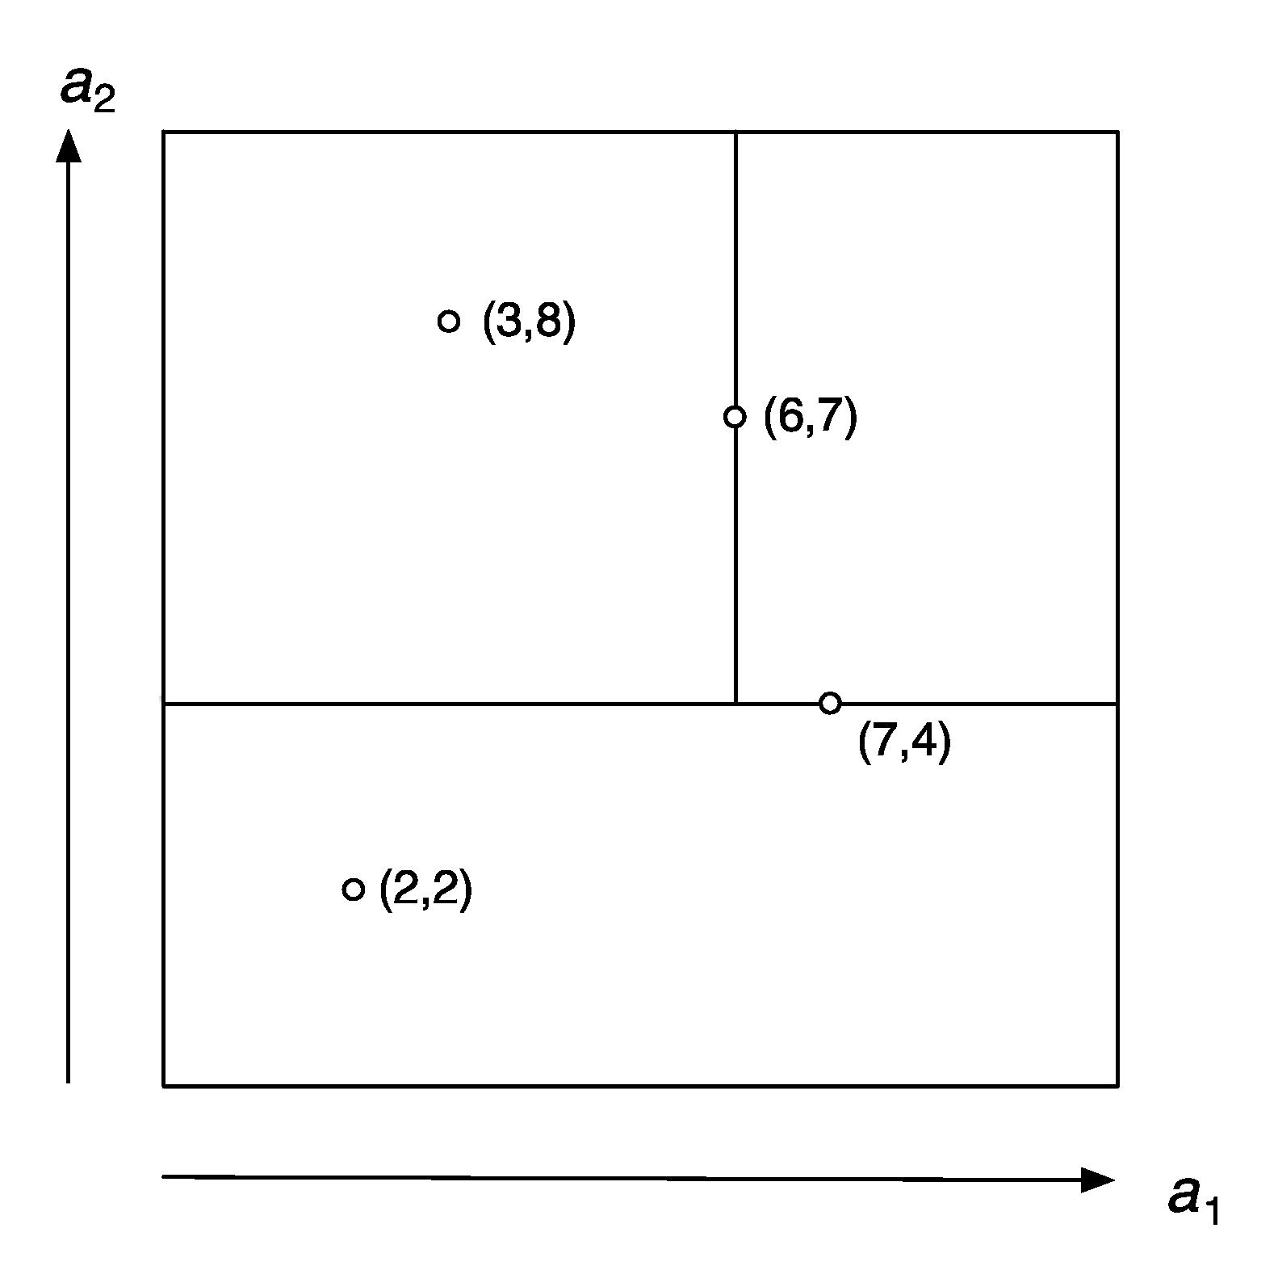
kD-tree example

Slide 94
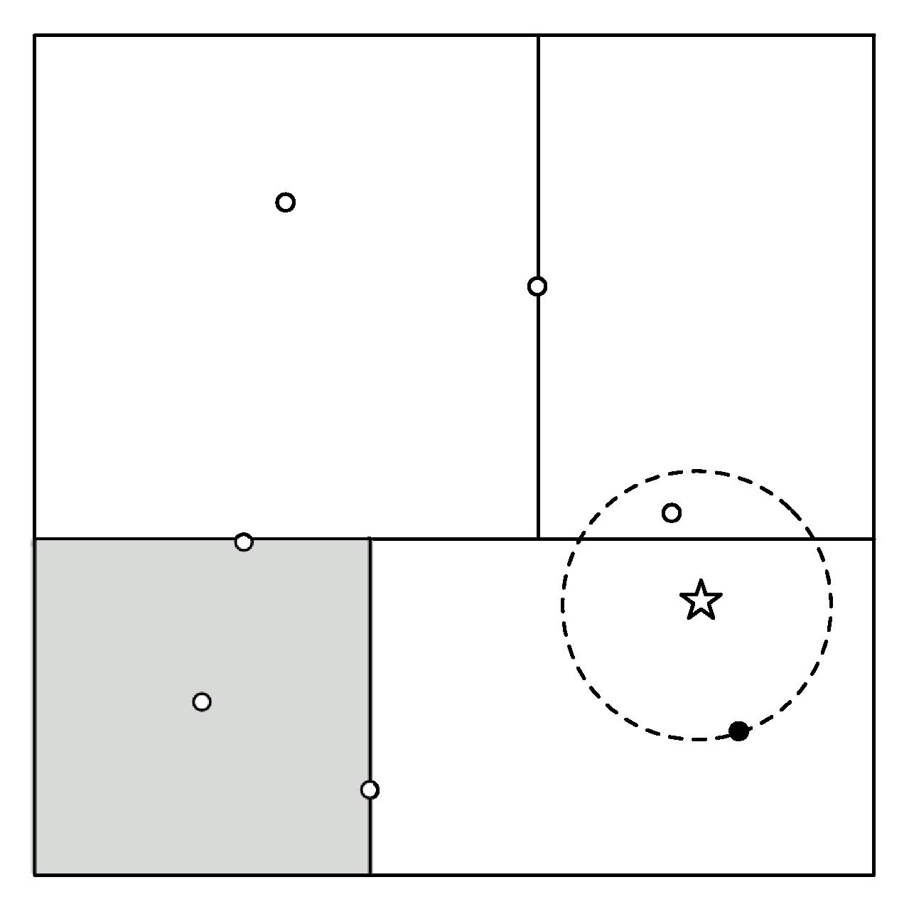
Using kD-trees: example

Slide 95
More on kD-trees
Complexity depends on depth of tree, given by logarithm of number of nodes
Amount of backtracking required depends on quality of tree (“square” vs. “skinny” nodes)
How to build a good tree? Need to find good split point and split direction
  Split direction: direction with greatest variance
  Split point: median value along that direction
Using value closest to mean (rather than median) can be better if data is skewed
Can apply this recursively

Slide 96
Building trees incrementally
Big advantage of instance-based learning: classifier can be updated incrementally
  Just add new training instance!
Can we do the same with kD-trees?
Heuristic strategy:
  Find leaf node containing new instance
  Place instance into leaf if leaf is empty
  Otherwise, split leaf according to the longest dimension (to preserve squareness)
Tree should be re-built occasionally (i.e. if depth grows to twice the optimum depth)

Slide 97
Ball trees
Problem in kD-trees: corners
Observation: no need to make sure that regions don't overlap
Can use balls (hyperspheres) instead of hyperrectangles
  A ball tree organizes the data into a tree of k-dimensional hyperspheres
  Normally allows for a better fit to the data and thus more efficient search

Slide 98
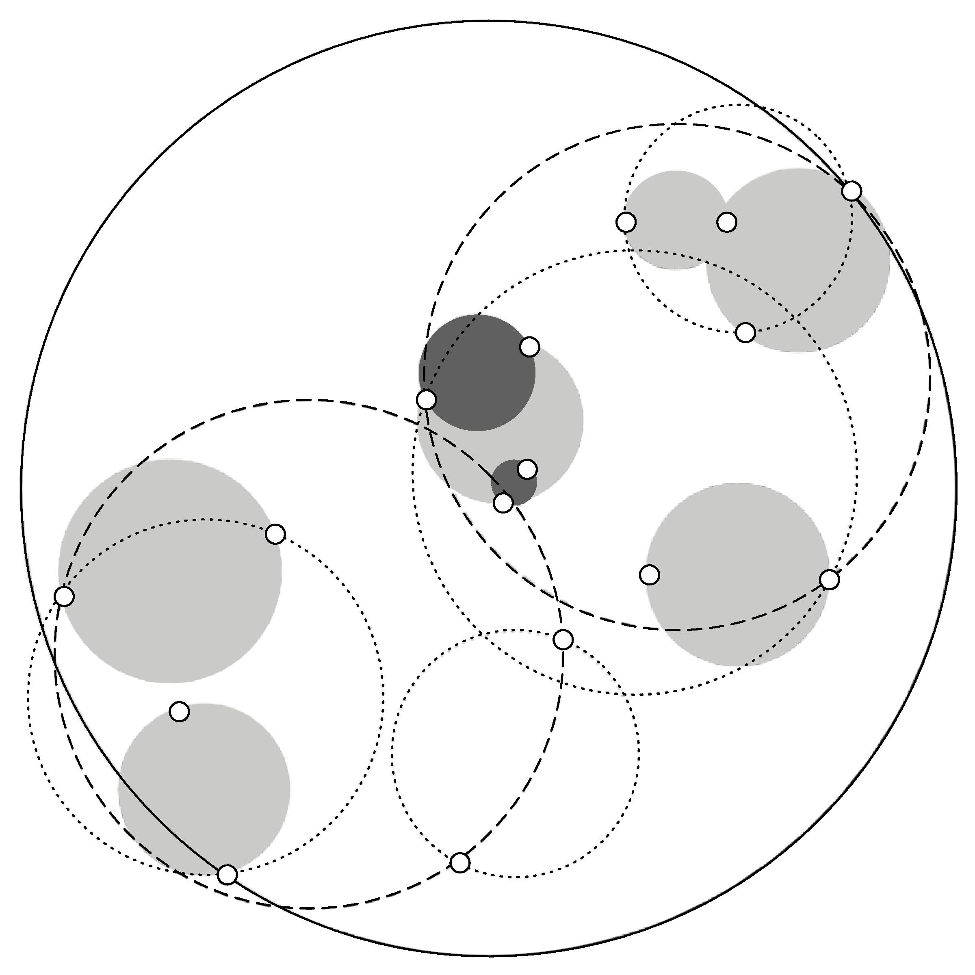
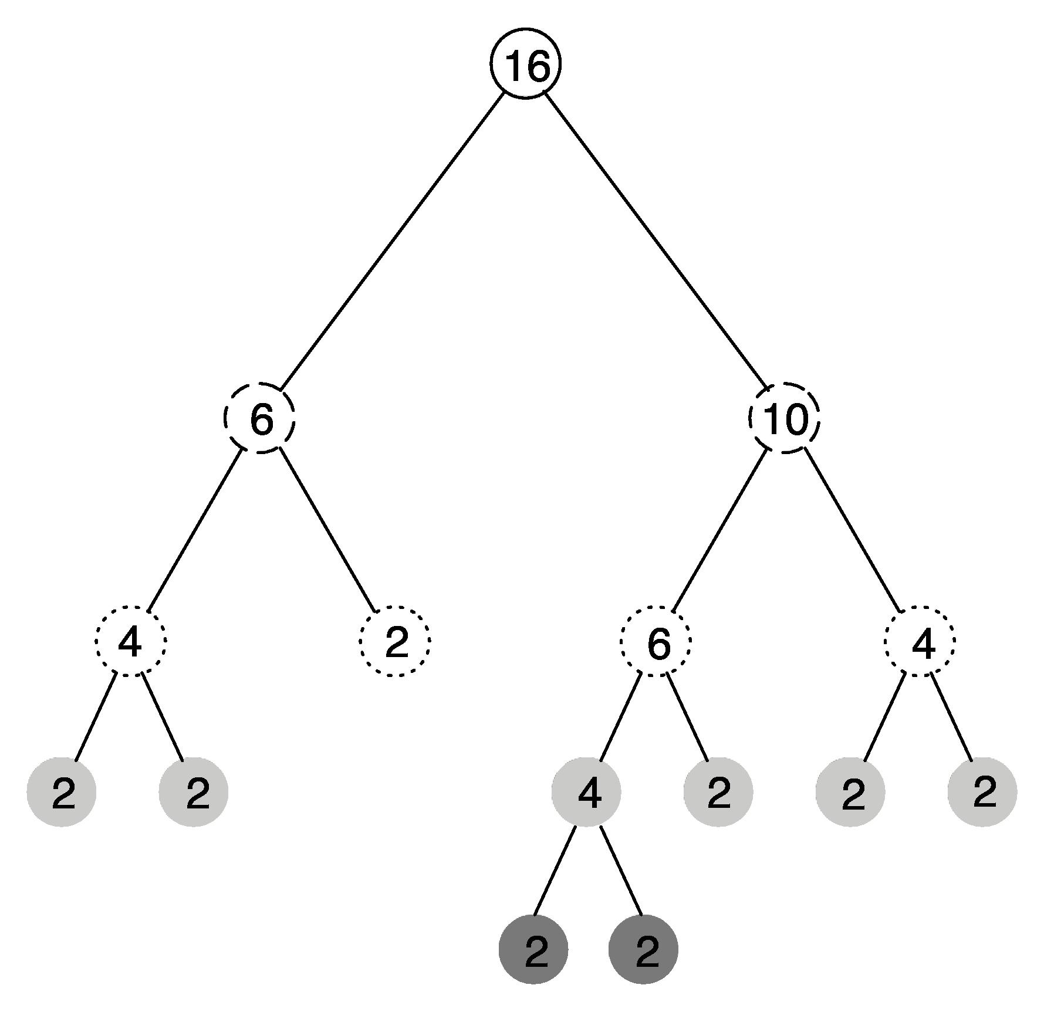
Ball tree example

Slide 99
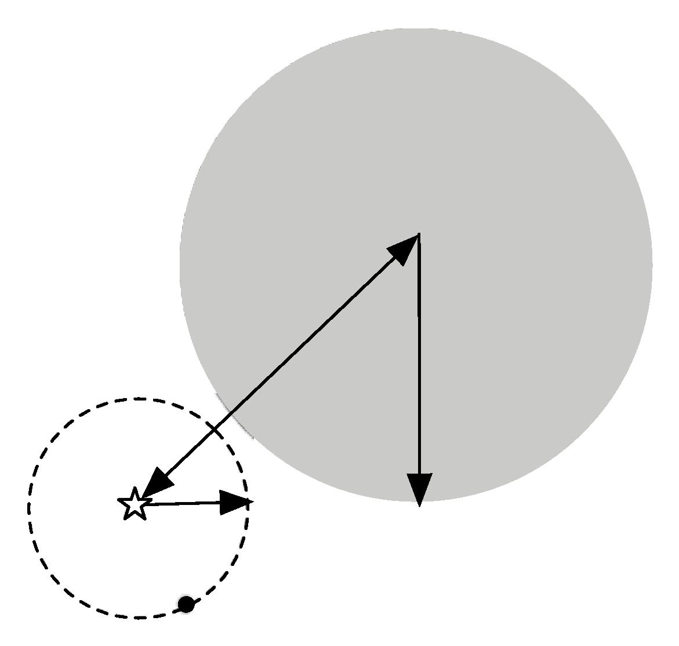
Using ball trees
Nearest-neighbor search is done using the same backtracking strategy as in kD-trees
Ball can be ruled out from consideration if: distance from target to ball's center exceeds ball's radius plus current upper bound

Slide 100
Building ball trees
Ball trees are built top down (like kD-trees)
Don't have to continue until leaf balls contain just two points: can enforce minimum occupancy
(same in kD-trees)
Basic problem: splitting a ball into two
Simple (linear-time) split selection strategy:
  Choose point farthest from ball's center
  Choose second point farthest from first one
  Assign each point to these two points
  Compute cluster centers and radii based on the two subsets to get two balls

Slide 101
Discussion of nearest-neighbor learning
Often very accurate
Assumes all attributes are equally important
  Remedy: attribute selection or weights
Possible remedies against noisy instances:
  Take a majority vote over the k nearest neighbors
  Removing noisy instances from dataset (difficult!)
Statisticians have used k-NN since early 1950s
  If n → ∞ and k/n → 0, error approaches minimum
kD-trees become inefficient when number of attributes is too large (approximately > 10)
Ball trees (which are instances of metric trees) work well in higher-dimensional spaces

Slide 102
More discussion
Instead of storing all training instances, compress them into regions
Example: hyperpipes (from discussion of 1R)
Another simple technique (Voting Feature Intervals):
  Construct intervals for each attribute
    Discretize numeric attributes
    Treat each value of a nominal attribute as an “interval”
  Count number of times class occurs in interval
  Prediction is generated by letting intervals vote (those that contain the test instance)

Slide 103
Clustering
Clustering techniques apply when there is no class to be predicted
Aim: divide instances into “natural” groups
As we've seen clusters can be:
  disjoint vs. overlapping
  deterministic vs. probabilistic
  flat vs. hierarchical
We'll look at a classic clustering algorithm called k-means
  k-means clusters are disjoint, deterministic, and flat

Slide 104
The k-means algorithm
To cluster data into k groups:
(k is predefined)
Choose k cluster centers
  e.g. at random
Assign instances to clusters
  based on distance to cluster centers
Compute centroids of clusters
Go to step 1
  until convergence

Slide 105
Discussion
Algorithm minimizes squared distance to cluster centers
Result can vary significantly
  based on initial choice of seeds
Can get trapped in local minimum
  Example:
To increase chance of finding global optimum: restart with different random seeds
Can we applied recursively with k = 2
initial cluster centres
instances

Slide 106
Faster distance calculations
Can we use kD-trees or ball trees to speed up the process? Yes:
  First, build tree, which remains static, for all the data points
  At each node, store number of instances and sum of all instances
  In each iteration, descend tree and find out which cluster each node belongs to
    Can stop descending as soon as we find out that a node belongs entirely to a particular cluster
    Use statistics stored at the nodes to compute new cluster centers

Slide 107
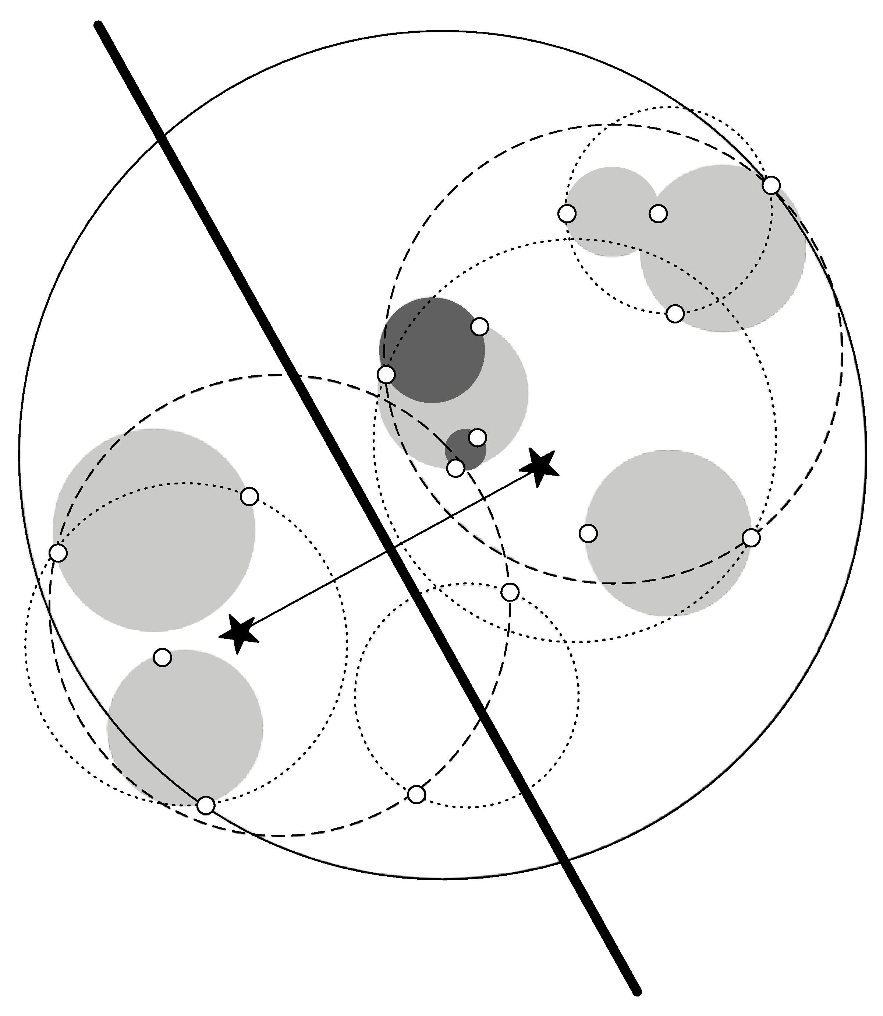
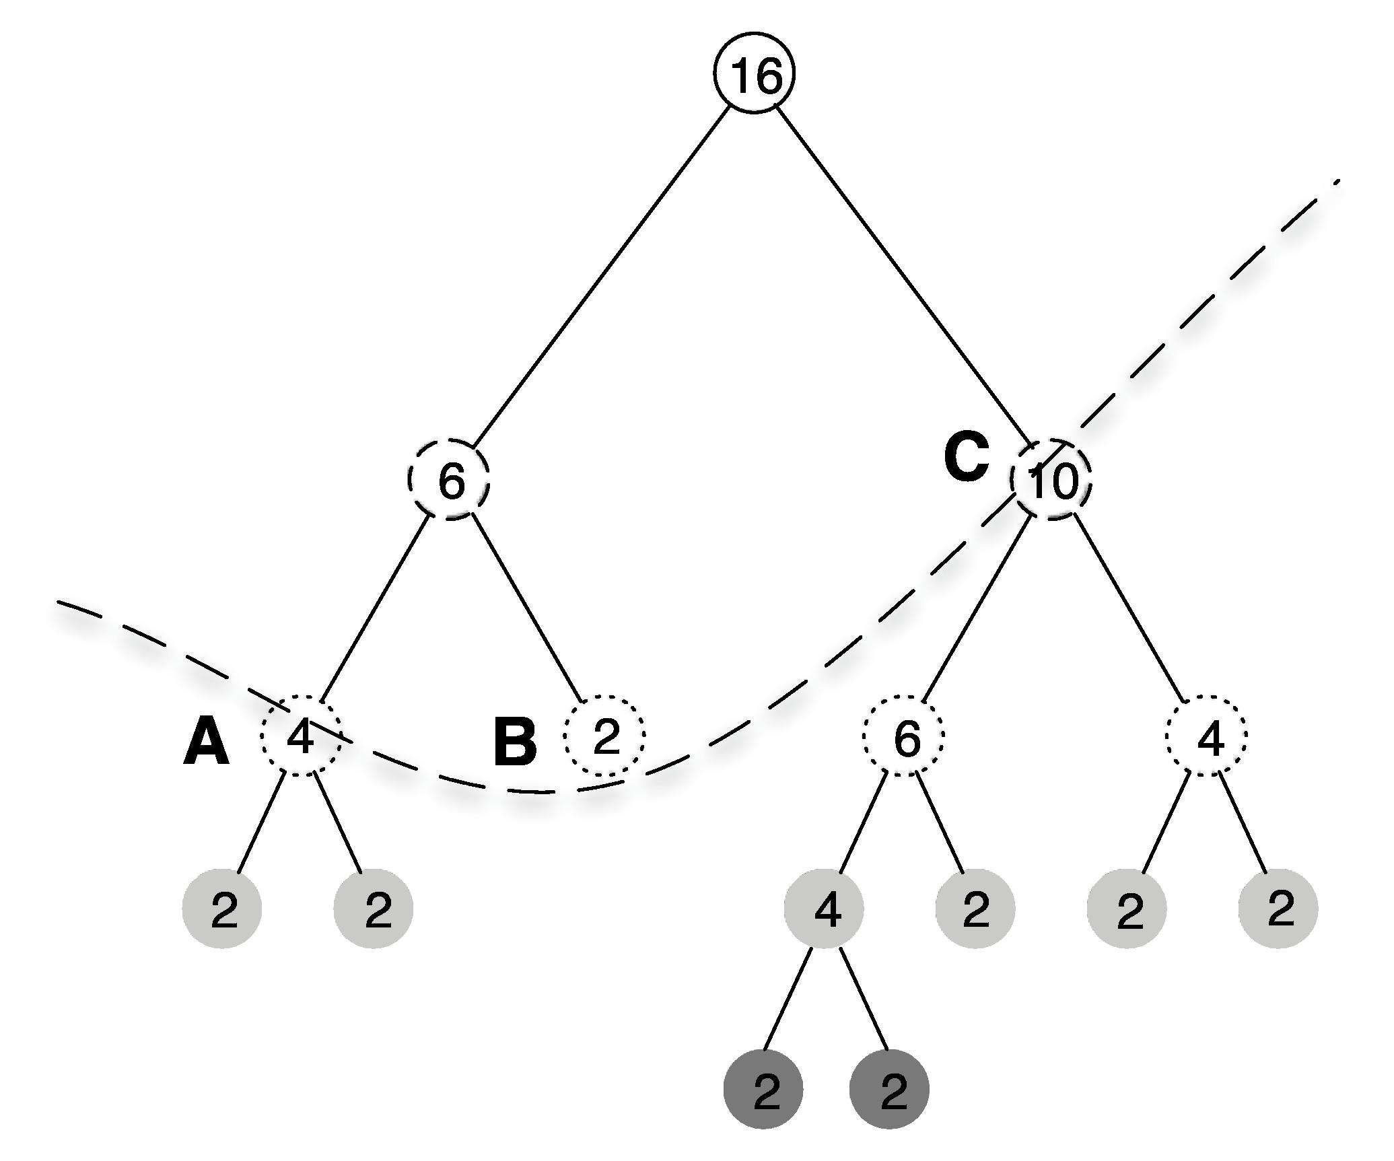
Example

Slide 108
Multi-instance learning
Simplicity-first methodology can be applied to multi-instance learning with surprisingly good results
Two simple approaches, both using standard single-instance learners:
  Manipulate the input to learning
  Manipulate the output of learning

Slide 109
Aggregating the input
Convert multi-instance problem into single-instance one
  Summarize the instances in a bag by computing mean, mode, minimum and maximum as new attributes
  “Summary” instance retains the class label of its bag
  To classify a new bag the same process is used
Results using summary instances with minimum and maximum + support vector machine classifier are comparable to special purpose multi-instance learners on original drug discovery problem

Slide 110
Aggregating the output
Learn a single-instance classifier directly from the original instances in each bag
  Each instance is given the class of the bag it originates from
To classify a new bag:
  Produce a prediction for each instance in the bag
  Aggregate the predictions to produce a prediction for the bag as a whole
  One approach: treat predictions as votes for the various class labels
  A problem: bags can contain differing numbers of instances → give each instance a weight inversely proportional to the bag's size

Slide 111
Comments on basic methods
Bayes’ rule stems from his “Essay towards solving a problem in the doctrine of chances” (1763)
  Difficult bit in general: estimating prior probabilities (easy in the case of naïve Bayes)
Extension of naïve Bayes: Bayesian networks (which we'll discuss later)
Algorithm for association rules is called APRIORI
Minsky and Papert (1969) showed that linear classifiers have limitations, e.g. can’t learn XOR
  But: combinations of them can (→ multi-layer neural nets, which we'll discuss later)

